Slide 1
Stop four: Old Fort Jackson__
This clip tours the fort so you can see the history and the buildings.
https://youtu.be/MxUQzDQlot0

Slide 2
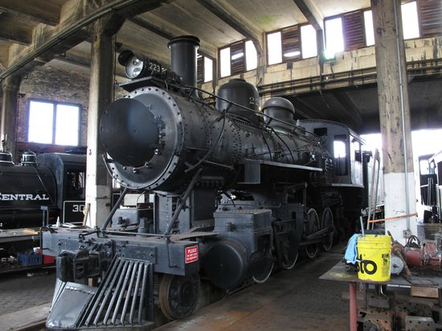
Stop five: Little Round House Railroad Museum

Slide 3
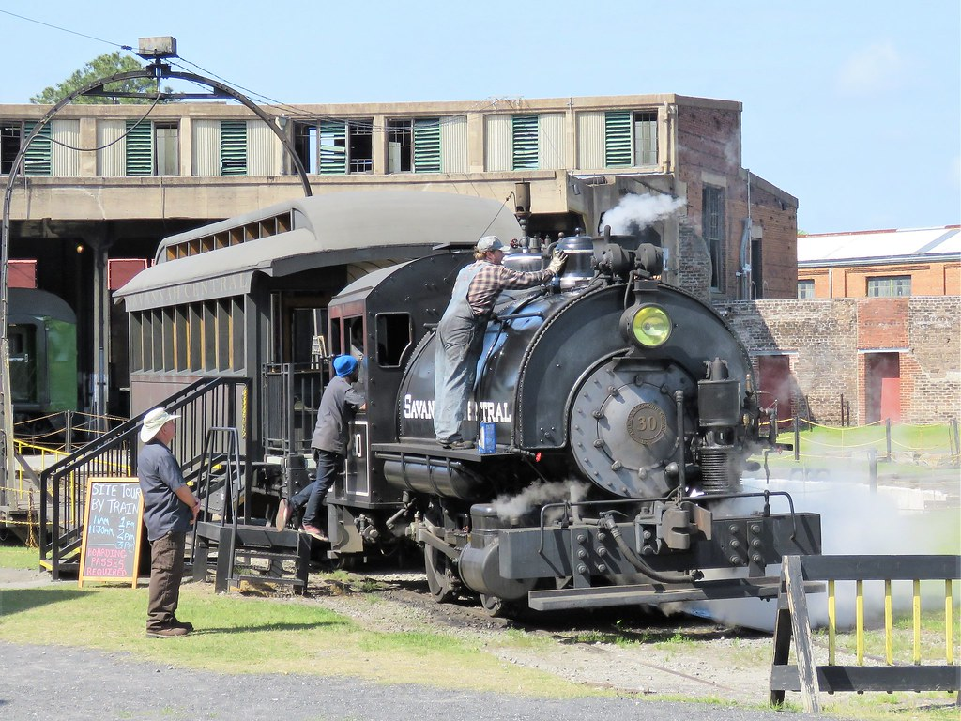
Railroad Museum
To tour the Little Round House Museum, watch this clip.
https://youtu.be/IaTsaoeuru4
The first 3-4 min. of this clip shows a steam engine train in action.
https://youtu.be/chavHi4hCVc

Slide 4
Stop six: Riverboat trip up the Savannah River
To take a Riverboat tour go to this link,
https://youtu.be/1mXsJ1UMzWU

Slide 5
Stop seven: Narrated trolley ride of the Historic district of Savannah
The Old Towne Trolley Tours promotional tour,
see the city and squares of Savannah,
https://youtu.be/qzhFk7TV9Hk
This car ride through the historic district
makes you feel like you are riding on a
trolley seeing the sights,
https://youtu.be/zFnyq3h6ZkU

Slide 6
Last stop: plan your own visit for the future…
Travelista has wonderful suggestions on this link to help you plan your own adventure to Savannah.
https://youtu.be/8zGiYRo7daI
I hope you make it one day to this historic Georgia city.
This Photo by Unknown Author is licensed under CC BY-SA

