Slide 1
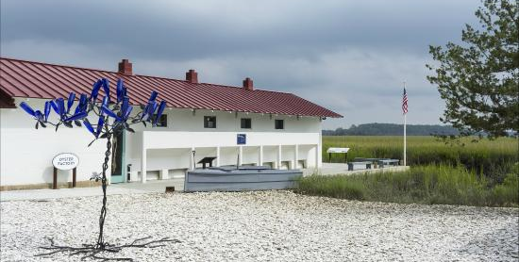
Stop two: Pinpoint Heritage Museum
https://youtu.be/VXoyfEh3xiA
3 min. tour of Gullah Geechee Heritage

Slide 2
Gullah-Geechee Heritage in music
McIntosh County Shouters: Gullah-Geechee Ring Shout from Georgia. Watch at least 10-15 to enjoy the unique character of this music.
https://youtu.be/uxPU5517u8c
Gullah Ring Shout Singers

Slide 3
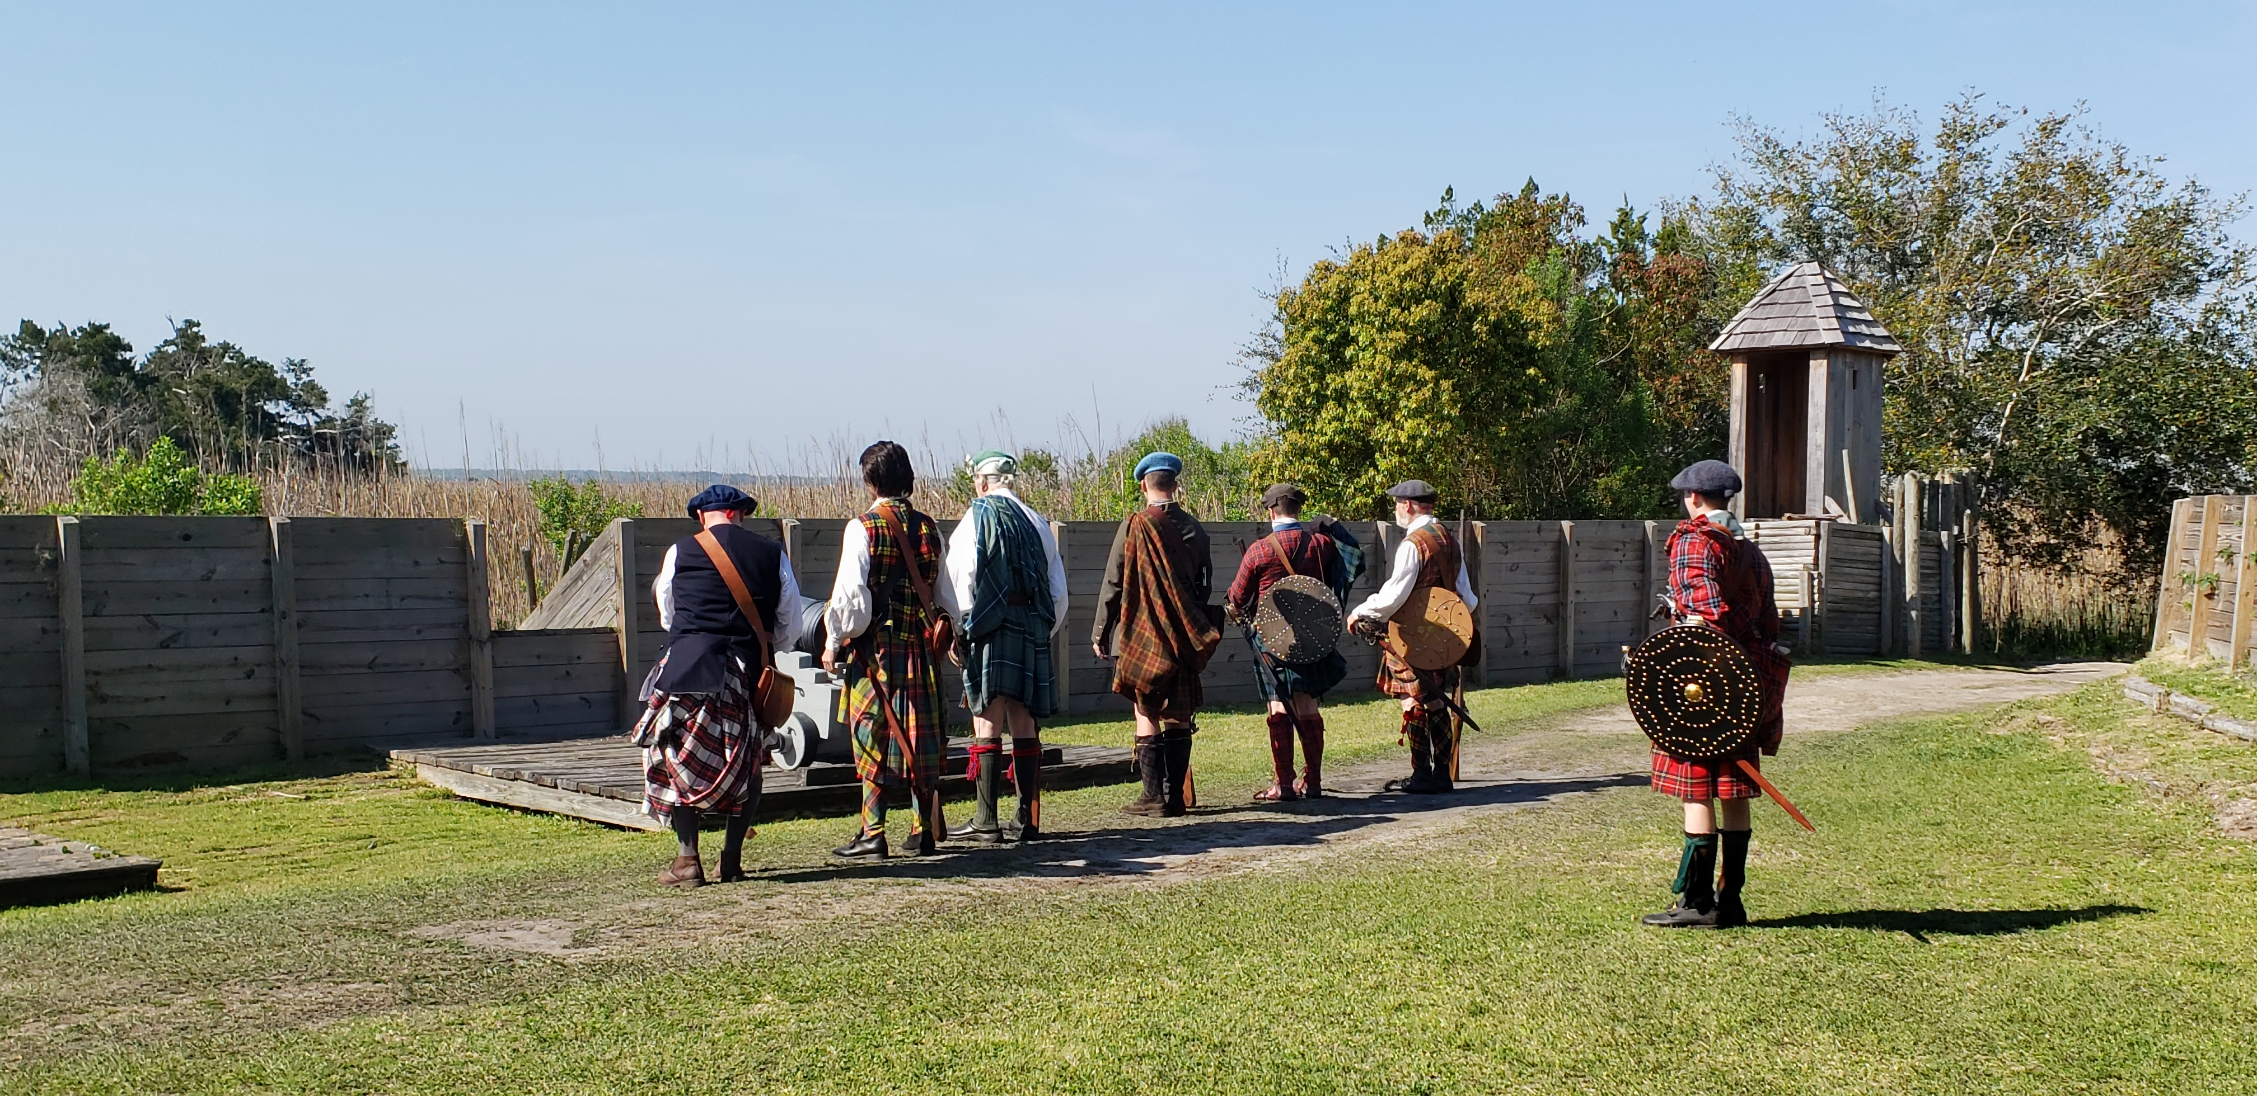
Stop three: Fort King George, Darien, GA
https://youtu.be/_hD7-m1noXc
Watch this 22 min. video tour of the fort.

