Slide 1
2020 Savannah Virtual Field Trip

Slide 2
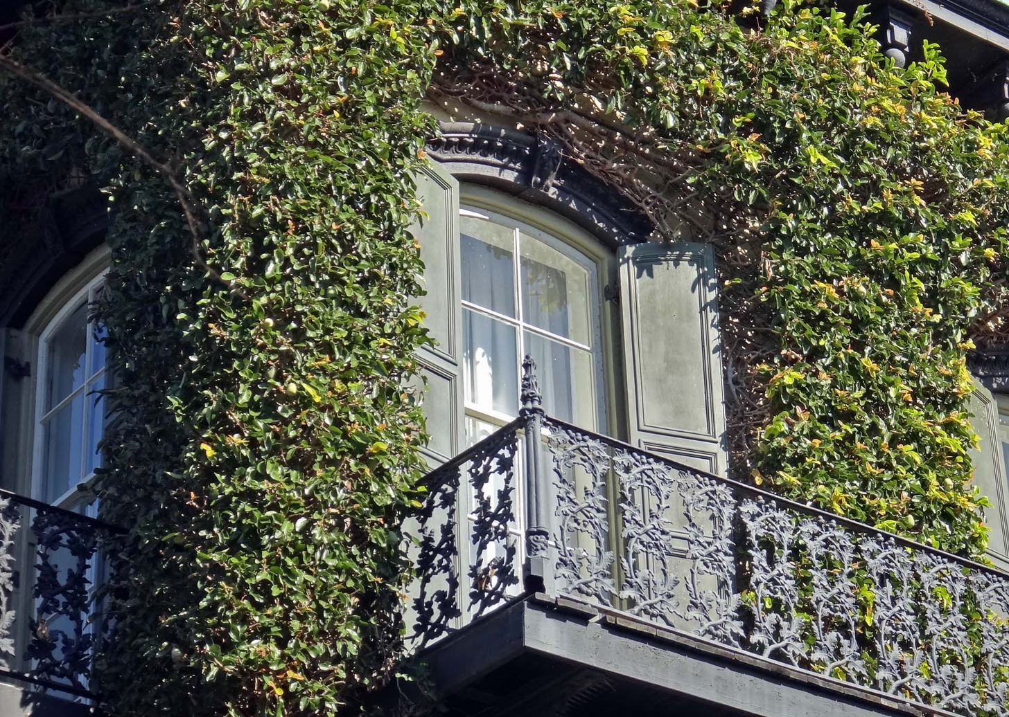
Savannah, a beautiful city filled with history and charm. The magic of the city is its culture.
https://youtu.be/5y7ejgpfwBw
This is a 5 min. preview of the city of Savannah.
This Photo by Unknown Author is licensed under CC BY-NC-ND

Slide 3
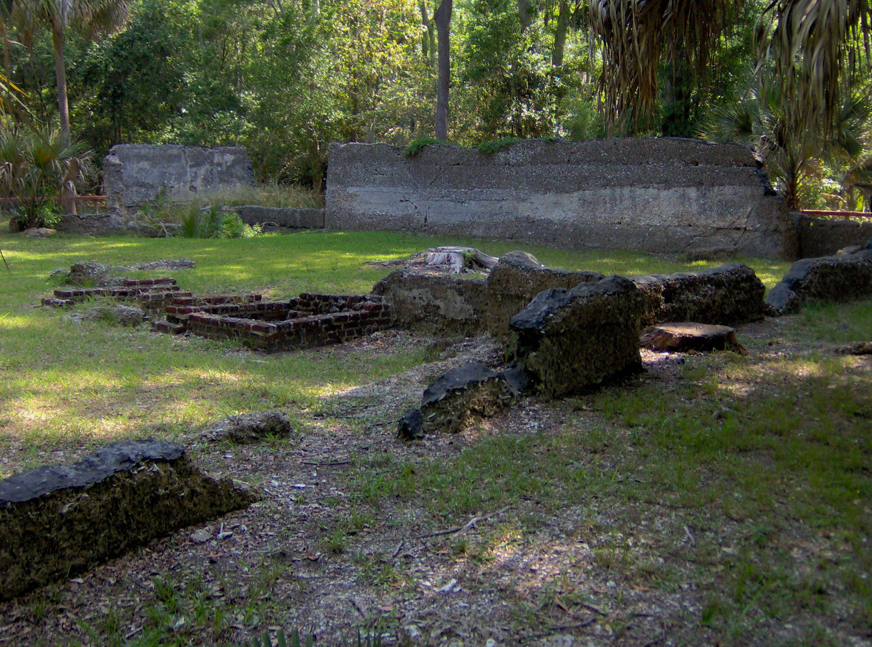
First stop: The ruins of Wormsloe Plantation. Owned by one of the founders of Georgia and who’s son fought in the Revolution.
Watch this 13 min. video tour
https://youtu.be/Q1yVFOo22oQ

